Slide 1
Notes to staff
Unintended Opportunities
This is designed for assembly or tutor time.
You can listen to the Pearl episode anywhere you get your podcasts to get the full story.
You can also download the transcript for your own preparation.
The assembly has been edited to fit more with students and be relevant to them.
There are notes at the bottom of each slide for reference.
We would love to hear how it has gone, email admin@pixl.org.uk

Slide 2
Glow Up

Slide 3
Guess the industry being described?
This industry:
Grew by 11% in 2023.
Sales reached £27.2 billion for products and services.
It has beaten publishing, chemical manufacturing, creative arts and entertainment industries.
The workforce increased by 10% from 2023-2024.
Globally the industry is thought to be worth $636.2 billion dollars.
Notes:
The beauty industry is one of the booming industries to take the world by storm over the last 5 to 10 years. The British Beauty Council reports that the British beauty industry grew by 11% in 2023 with sales reaching £27.2 billion pounds for both products and services. This growth now puts the beauty industry ahead of publishing, chemical manufacturing and the creative arts and entertainment industries. It is an industry that is also attracting a lot of workers. The industry’s workforce was estimated to be 418,000 in 2023, a 10% increase on the previous year.
It is not just in the UK, worldwide the global figures are staggering. In 2025, the global beauty industry is expected to be worth $636.2 billion dollars.

Slide 4
The Beauty Industry
But why?
Notes:
So why the increase in revenue, exposure and popularity? What has happened to make the beauty industry boom?
The industry has shown resilience in the face of economic challenges. Some believe that it has benefitted from the ‘lipstick effect’ where people still want to indulge in the small luxuries when times are economically tough. That is partly what is responsible for the UK increase of 11% in 2023, commentators believe.

Slide 5
Why the sudden increase?
Social media
Influencers (both famous and less famous)
65% of all consumers come through an influencer!
Notes:
Social media is a significant factor in the growth. Famous personalities, and even some not so famous are creating videos starting with, “So many of you have been asking about my skincare routine…” and a video of all their beauty products follows. Maybe people have been asking, maybe they haven’t, it almost doesn’t matter – it is the perception of popularity that counts…and sells. 65% of all consumers went to a product because an influencer had suggested it through social media.

Slide 6
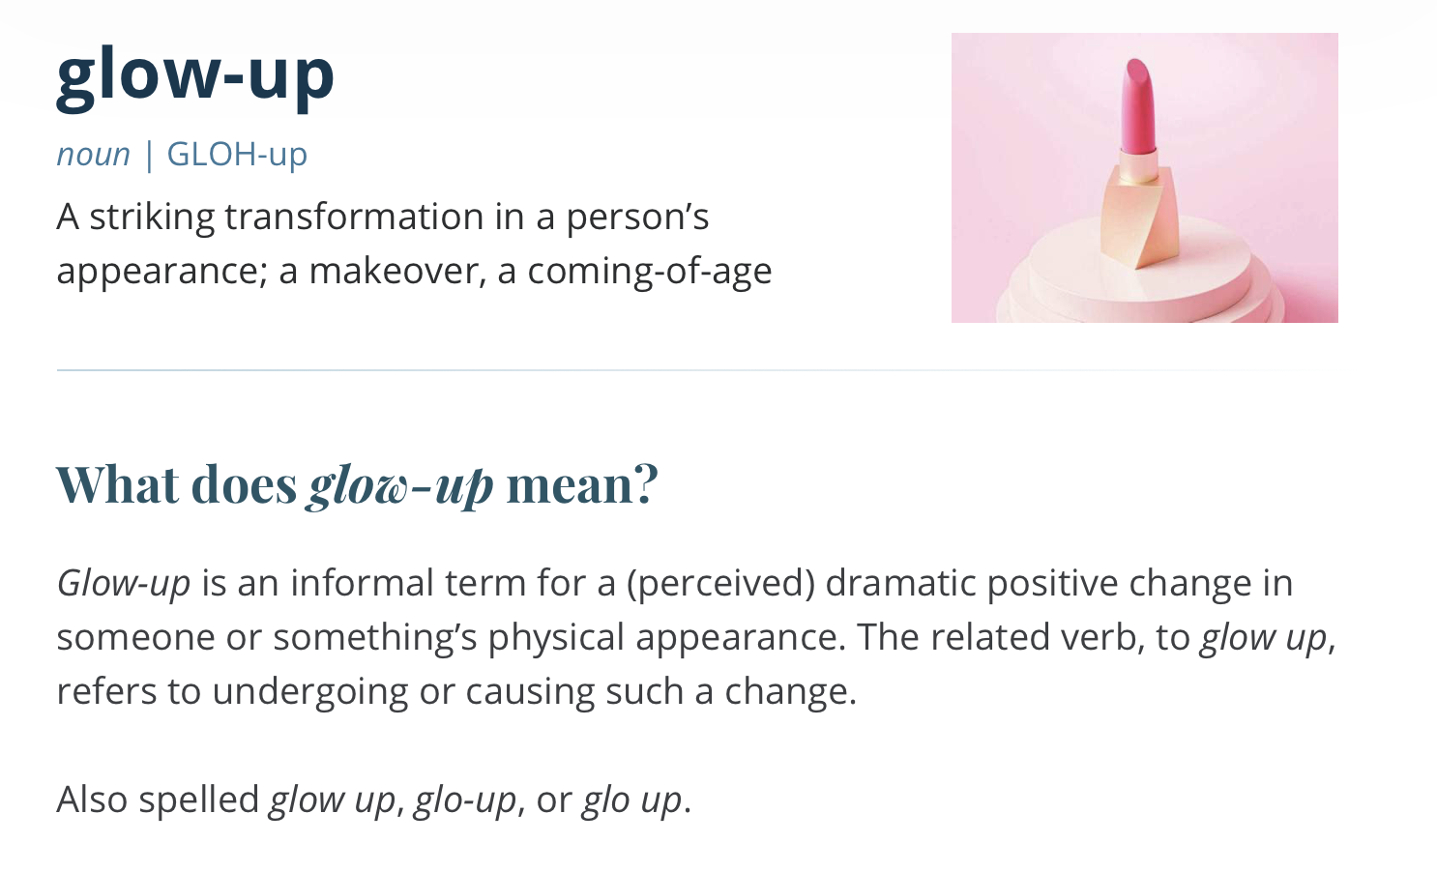
A whole new WORD
Merriam Webster Dictionary
Notes:
The industry has also created a whole new lexicon too with a growing emphasis on ingredients that use the most scientific sounding name, to new techniques like ‘contouring’ all to achieve a ‘glow up’.
A ‘glow up’ is the new slang term for a positive personal transformation. This can mean noticeable changes in appearance or style but has also been expanded to encompass a growth in maturity and confidence too. It can stretch to any change that has been made which means that someone is thriving when previously they may have encountered a difficult or awkward time.
https://www.merriam-webster.com/slang/glow-up

Slide 7
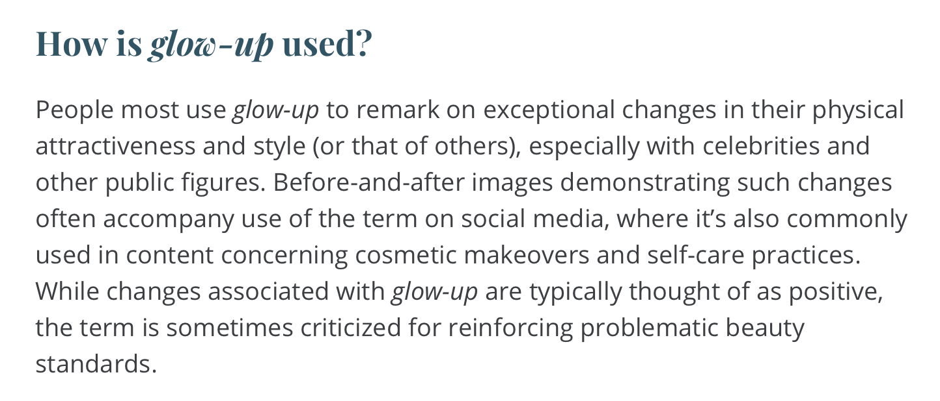
Merriam Webster Dictionary
Notes:
20 years ago, perhaps we would have called this ‘growing into yourself’ or overcoming ‘the awkward phase’ when you are trying to work out who you are. The earliest ‘glow up’ many people in their 30/40s can remember is when they watched Neighbours in the 1980s as a 10-year-old and Plain Jane Superbrain took her ponytail out, took off her glasses and put some makeup on and the world went mad with excitement. According to Wikipedia it is still a reference point culturally for extreme makeovers.
Whatever your views on the beauty industry, social media or ‘glow ups’, it appears that this particular industry is going through its very own ‘glow up’ with no signs of stopping.

Slide 8
The pattern is for all genders
Barclays data shows that over the last 5 years, men’s spending on pharmacy, health and beauty categories has increased by 58.1% which is higher than the figures for women, which are 45.7% for the same period.
Source: Connected: Focussing on Me and We, Rachel Johnson (2026)

Slide 9
Is beauty really about your appearance though?

Slide 10

Can we ‘glow up’ on the inside?
YES!
Notes:
In the beauty industry, there are step-by-step guides for pretty much everything: how to apply this, or make your hair do that, but what about our insides? Our hearts and our minds need looking after every bit as much as our faces and bodies, perhaps even more.
There are studies that suggest that an internal change can lead to a ‘glow up’ externally too… Why? Because how beautiful someone thinks you are, is linked to how you behave, make them feel and your character. Whilst initial attraction can be sparked by physical appearance, the research suggests that it is your good character that can deepen your perceived ‘beauty’. It also works the other way though: you may be seen to be attractive on the outside but if you have negative character traits on the inside, studies show that it impacts how attractive people think you are.

Slide 11
Honesty makes you more beautiful.
Notes:
Honesty makes you more beautiful. One study showed that the phrase, ‘what is good is beautiful’ is right. People in the study were asked to rate the attractiveness of lots of people. They were then given a personality description of those people. Then they had to look at their attractiveness rating again. The people who had been described as honest were given higher attractiveness scores by the participants. This is known as the ‘honesty premium’ and was found to increase the level of attractiveness in the people in the study, regardless of their starting attractiveness score. This ‘honest premium’ effect occurred regardless of how attractive the person’s clothes were!
Source: Connected: Focussing on Me and We, Rachel Johnson (Hachette, May 2026)

Slide 12
Kindness is attractive.
Notes:
Kindness is attractive. Some studies have shown that kindness, warmth of personality and generosity were seen as more attractive than intelligence or sense of humour. When people were consistently kind, this was even more effective in attractiveness scores. This is sometimes known as the ‘halo effect’. The opposite is also true, those who showed rudeness, lack of kindness and empathy were seen as less attractive to the observers in the study.
Source: Connected: Focussing on Me and We, Rachel Johnson (Hachette, May 2026)

Slide 13
Familiarity can help us ‘glow up’.
Notes:
Familiarity can help us ‘glow up’. Beauty fades, character deepens. This is known as the ‘Familiarity Effect’ because knowing someone can make them more attractive over time. The more comfortable you feel and the more you deepen your understanding of them and they of you, the more you might change your view based on physical appearance alone. Instead of obsessing only over what we wear or what we look like, perhaps we should obsess just as much over talking to people, listening to them, getting to know them and sharing interests and values.
Source: Connected: Focussing on Me and We, Rachel Johnson (Hachette, May 2026)

Slide 14
We can go for the ‘double glow up’… but one is more important longer term than the other.

Slide 15
Glow up this week
Try one of these:
Who can you be yourself with this week? Be honest about your feelings.
Find small ways to be kind, polite and encouraging.
When looking in the mirror say, “insides too!” to remind you that character is just as important, if not more so!

