Slide 1
Notes to staff
Taylor
This is designed for assembly or tutor time.
You can listen to the Pearl episode anywhere you get your podcasts to get the full story.
You can also download the transcript for your own preparation.
The assembly has been edited to fit more with students and be relevant to them.
There are notes at the bottom of each slide for reference.
We would love to hear how it has gone, email admin@pixl.org.uk

Slide 2
Taylor

Slide 3
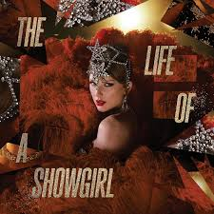
Taylor Swift…
…needs no introduction
Song writing talent
Cult-like fan base
Multiple award winner
Broken all records
Notes:
Taylor Swift is a phenomenon. The combination of her song writing talent, her approach, her courage and her cult-like fan base mean that we have not seen anything quite like this before and we may not ever see it again. Swift has achieved multiple Grammy wins, record-breaking album sales and has the highest-grossing concert tour of all time. She is the fastest-selling artist, the most streamed and has spent more time in the Billboard Top 100 than anyone else. She can quite literally break the internet and has done so on many occasions. When she appears on podcasts streamed through YouTube, the volume of traffic makes it crash. When she launched the dates for her Eras tour, Ticketmaster could not cope with the demand and their website crashed.
All of this is a phenomenon and what she has achieved is phenomenal. Fewer than 10 of those signed artists achieve commercial success and many never get a chance to even release music, so what set her apart?

Slide 4
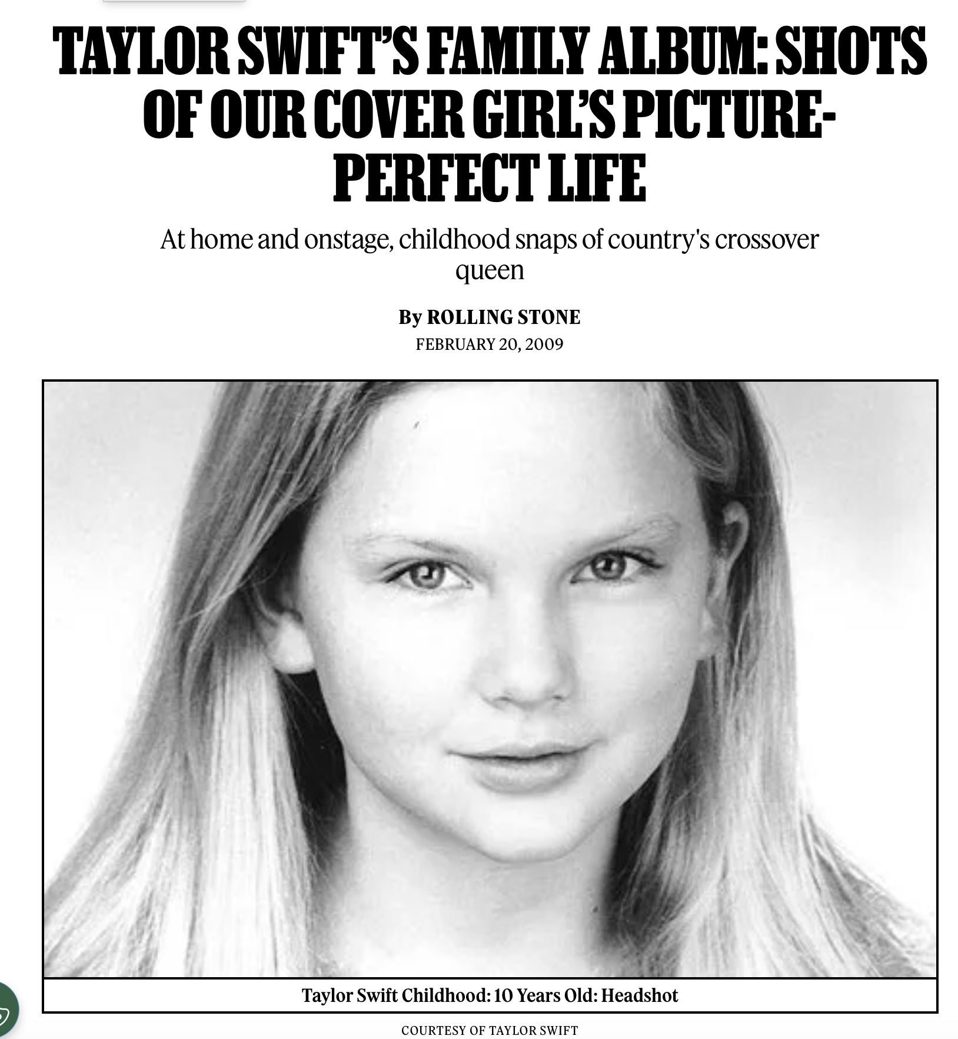
At only 13, Taylor Swift knew what she wanted
Didn’t want to compromise
Country music
By a teenage girl, FOR teenage girls
Her own ‘Swift Twist’
Wanted to write her own music
Notes:
Taylor Swift knew what she wanted at 13 and she was not prepared to compromise. She was a teenager and wanted to sing country music aimed at teenage girls. She could not understand why country music was seen as something for middle-aged or aging adults about the pains of life. Her life was painful too in its own way, so why shouldn’t she write about it? So, she did. Her own songs, with conventions borrowed from country music but with her own Swift twist.
Article credit: https://www.rollingstone.com/music/music-lists/taylor-swifts-family-album-shots-of-our-cover-girls-picture-perfect-life-214330/

Slide 5
Brave decisions
Swift wanted to do things differently
Waited for her mentor to set up his own record label and sign her.
She didn’t sign the first deal she was offered.
She didn’t think she was taking a risk – saw it as ‘unfettered opportunities’.
She didn’t write the music she was being asked to write.
Notes:
Swift also made savvy decisions that only appear savvy in hindsight. She could have signed with a big label and had the chance to do so OR she could wait for the person who she had been working with IN the big label to set up his own start-up and work with him there. Scott Borcetta believed in her and said that if she could wait, he would leave, set up his new label and make her the first signing. Swift could have been inpatient, could have followed the path of commercial sense but she didn’t. She wanted people who were as passionate about her music as she was and in Borcetta she had found that. Others around her saw deeply risky challenges but Swift and Borcetta saw ‘unfettered opportunities’. Much later, however, things between the pair soured due to their working relationship and the result of that has been much documented.

Slide 6
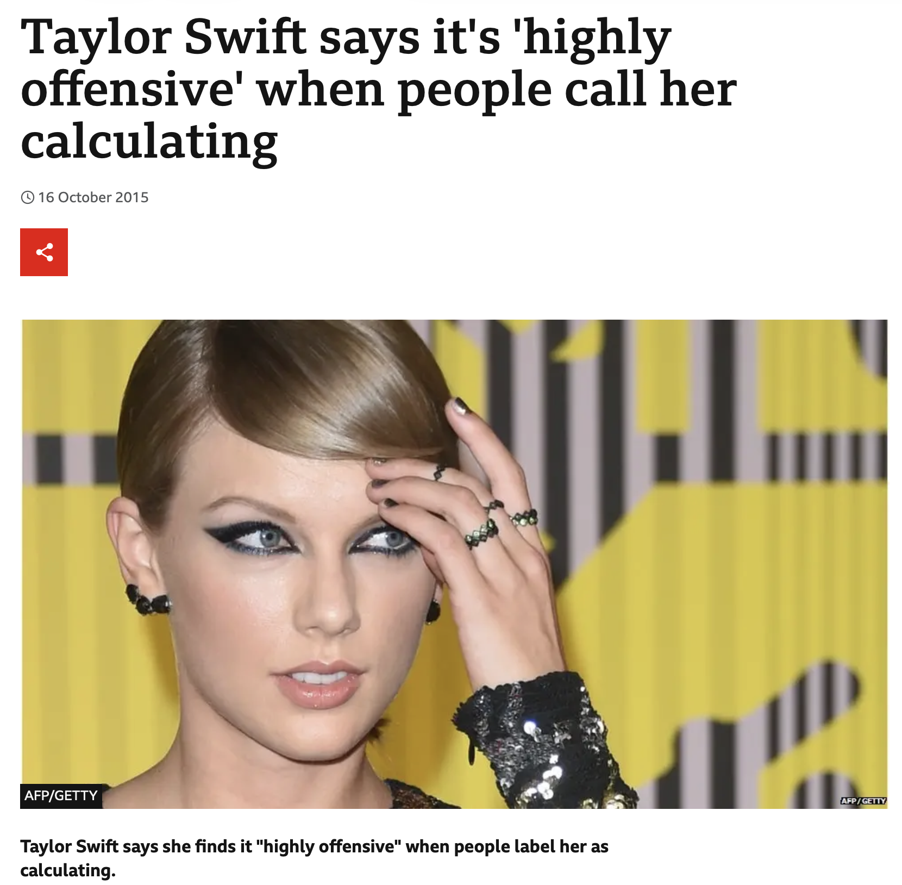
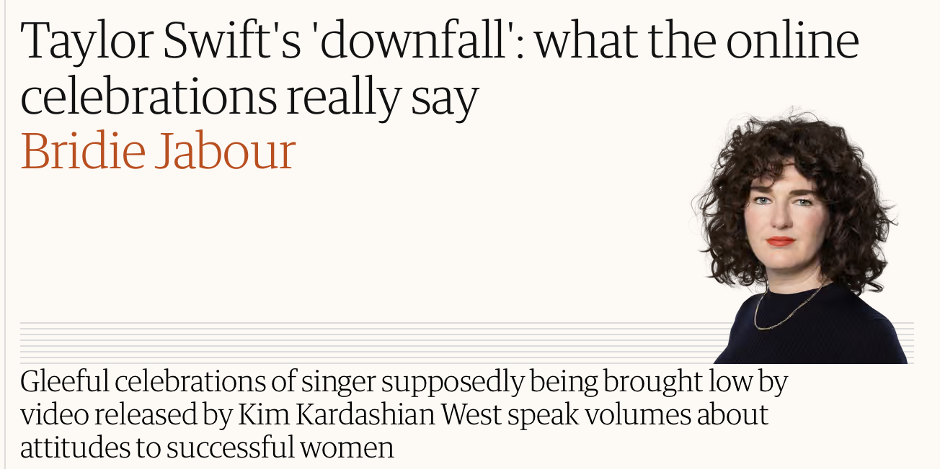
It hasn’t always been easy though…
The Guardian in 2016
BBC October in 2015
Notes:
An artist like Swift could have been tempted to play it safe. But she didn’t. She has changed her style, her song writing, her record label, her approach and she has grown in confidence as she’s grown in age. Not all of her songs or albums have been received well though… and not everyone has been a fan. Kanye West was perhaps the most public detractor. At the MTV awards in 2009, West interrupted Swift saying that Beyonce should have won the award she had just claimed. This was not the end of the incident – a feud then continued playing out in social media, song writing and music videos with allegations from both sides.
Swift has also braved the criticism. Some called her strategic, others called her calculating. Some called her authentic, others accused her of unfairly publicly shaming her exes. Some call her approach to marketing ‘genius’, others say it’s nothing more than hype. The fact she knows all of this and has played with her reputation as the accusations have come in, says something about her ‘fearlessness’. A word that is often used for Swift. When she faces a knock, she seems to come back fighting.
Guardian article: https://www.theguardian.com/commentisfree/2016/jul/18/taylor-swift-kanye-west-kim-kardashian-west-famous-reaction
BBC article: https://www.bbc.co.uk/news/newsbeat-34550092

Slide 7
What can we learn about Taylor Swift’s attitude and approach?

Slide 8
Know what you believe in
Head for the ‘blue ocean’.
Swift stuck to what she believed.
She headed for the space that no-one else like her was in.
She kept focused on the big picture.
She planned her success.
Notes:
Know what you believe in. Identify the blue ocean and the red ocean. The success that Swift has was ‘improbable but not impossible’. She trusted her instincts, aimed at a female teenager audience and insisted on writing her own songs. By doing all of that she tapped into an uncontested market space called ‘the blue ocean’. W Chan Kim and Renee Mauborgne’s book ‘The Blue Ocean Strategy’ explains that whilst the blue ocean is the uncontested market, the red ocean is the existing market where there is already lots of competition. When we head for the ‘blue ocean’ we are looking again at what we think we know, we are focused on the big picture, overcoming organisational hurdles and executing our strategy. What we are not doing is trying to do what everyone else is doing already.

Slide 9
You may not want a career in music but…
You can…
Think about what can make you different. What skills or knowledge could you learn that sets you apart?
Think about the big picture. What will working hard now help you achieve in the future?
Start! Taylor Swift planned for the thing she wanted. What do your plans look like? Have you got an idea of what you want to achieve?

Slide 10
Change can happen!
Sometimes we think/feel that we can’t change anything but…
We can change what we want to achieve.
We can change our attitude.
We can change our approach.
We can change what we know and can do.
We can change some of the people who we have around us to help us.

Slide 11
For that we need…
Determination
Imagination
Knowledge
Curiosity
Courage
Resilience
Motivation

Slide 12
Things can look impossible, until you plan one step at a time to make them possible.

