Slide 1
Notes to staff
Unintended Opportunities
This is designed for assembly or tutor time.
You can listen to the Pearl episode anywhere you get your podcasts to get the full story.
You can also download the transcript for your own preparation.
The assembly has been edited to fit more with students and relevant to them.
There are notes at the bottom of each slide for reference.
We would love to hear how it has gone, email admin@pixl.org.uk

Slide 2
Comfort

Slide 3
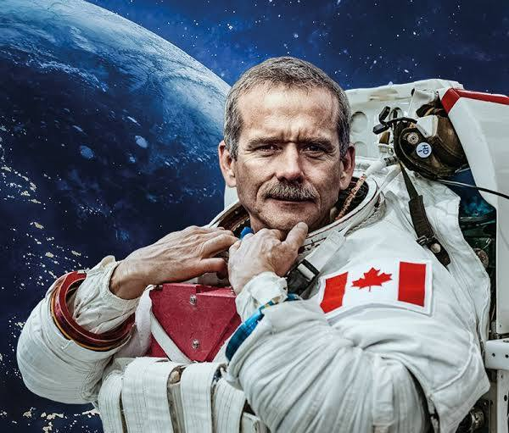
Chris Hadfield
A Canadian Astronaut
The first Canadian to walk in space
Commanded the International Space Station
A fighter pilot and a test pilot
An aeronautical engineer
Yet he didn’t expect to go to space
Notes:
Chris Hadfield is best known for being the first Canadian to walk in space and for commanding the International Space Station. His skills are extraordinary: he is a fighter pilot, a test pilot and an aeronautical engineer, capable of docking a rocket ship… although he is quick to point out it is not at all like parking a car!
When he was selected for Canada’s space programme, Hadfield had no real expectations of going to space and certainly did not feel he was destined to be an astronaut. He said he had to ‘turn himself into one’. There are manuals, programmes and protocols around how space agencies turn people into astronauts. Of course, there are qualifications, knowledge and skills, drills and hundreds of checklists to be completed to give people a chance of making it. But one of the biggest concerns space agencies have around sending people to space? Whether they can handle the pressure, the isolation and the threat of potential disaster.

Slide 4
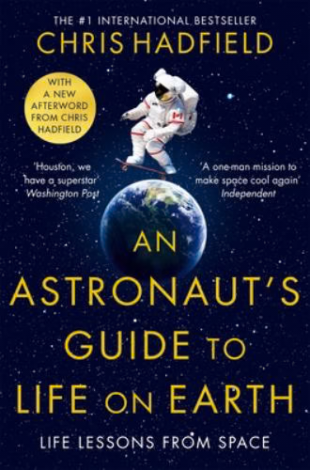
What is it like to live in space?
What can we learn for our lives on Earth?
Notes:
But how DO you handle months in space, isolated from the world with no guarantee you will return safely?

Slide 5
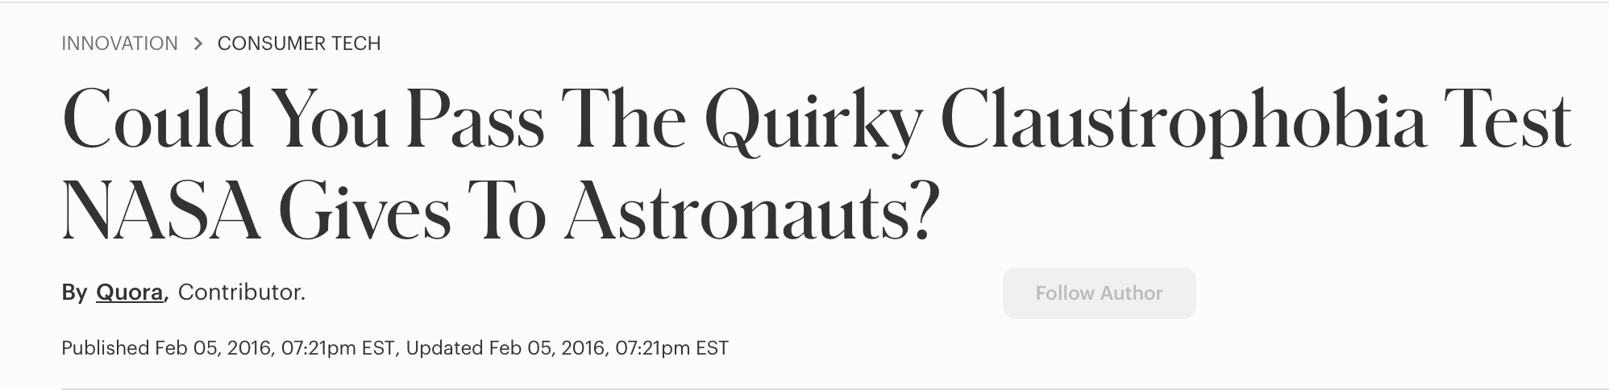
The Stress Tests
Notes:
Each would-be astronaut is stress-tested to ensure they can cope in intense pressure. Fears have to be identified, especially if they could compromise a mission. To flush out some of these fears they simulate the experiences. At the time when Hadfield was training, he was zipped inside a beach ball, which was made mostly dark. He was not told when he would be let out. Anyone who suffered from claustrophobia would object or struggle and would not be selected. Hadfield took the challenge in his stride, thinking that it was a great opportunity to be in a small space, with good air where he could do nothing for a while. He called the experience ‘beautiful’!
https://www.forbes.com/sites/quora/2016/02/05/could-you-pass-the-quirky-claustrophobia-test-nasa-gives-to-astronauts/

Slide 6
Being Prepared for Space
Astronauts are trained on:
How they will handle bad news in space
What will happen in an emergency
How they would cope if someone on Earth died
How they will work together to do all that needs to be done
Notes:
The emotional challenges continue through disaster simulations. Can they avoid paralysis in those first moments of moving through checklists and protocols in an emergency situation? How would they cope in space if they heard of the death of a loved one? Through an exercise known unofficially as ‘death sims’, partners are invited along too as they anticipate every possible eventuality and how it would feel. As a small team of 6 astronauts, probably all in their 30s, 40s or 50s, it is highly likely that family emergencies will crop up whilst they are in space. The teams discuss if a family member died, how would they support each other, what would they do? Sadly, Hadfield’s crew had to deal with exactly this scenario when one of their mothers died whilst they were in space.
Getting through such an experience is one thing, living with it after it has happened is another. NASA have long recognised the problem of the crashing anti-climax. Once your eyes have seen the world from afar, felt the weightlessness of space and been removed from life as they know it, coming down to earth, both literally and figuratively, can be a problem.
Even after Hadfield’s third space flight he was constantly aware that if the mechanics of the actual mission didn’t kill him, the mind-warp just might. Living in space for half a year, in a space station the size of a 5-bedroom house with up to 5 people meant that those 5 people become your entire life. They are your town. Every skill that is needed is in that one, secluded place. And if something goes wrong, if the one doctor on board dies, nobody can come and get you.

Slide 7
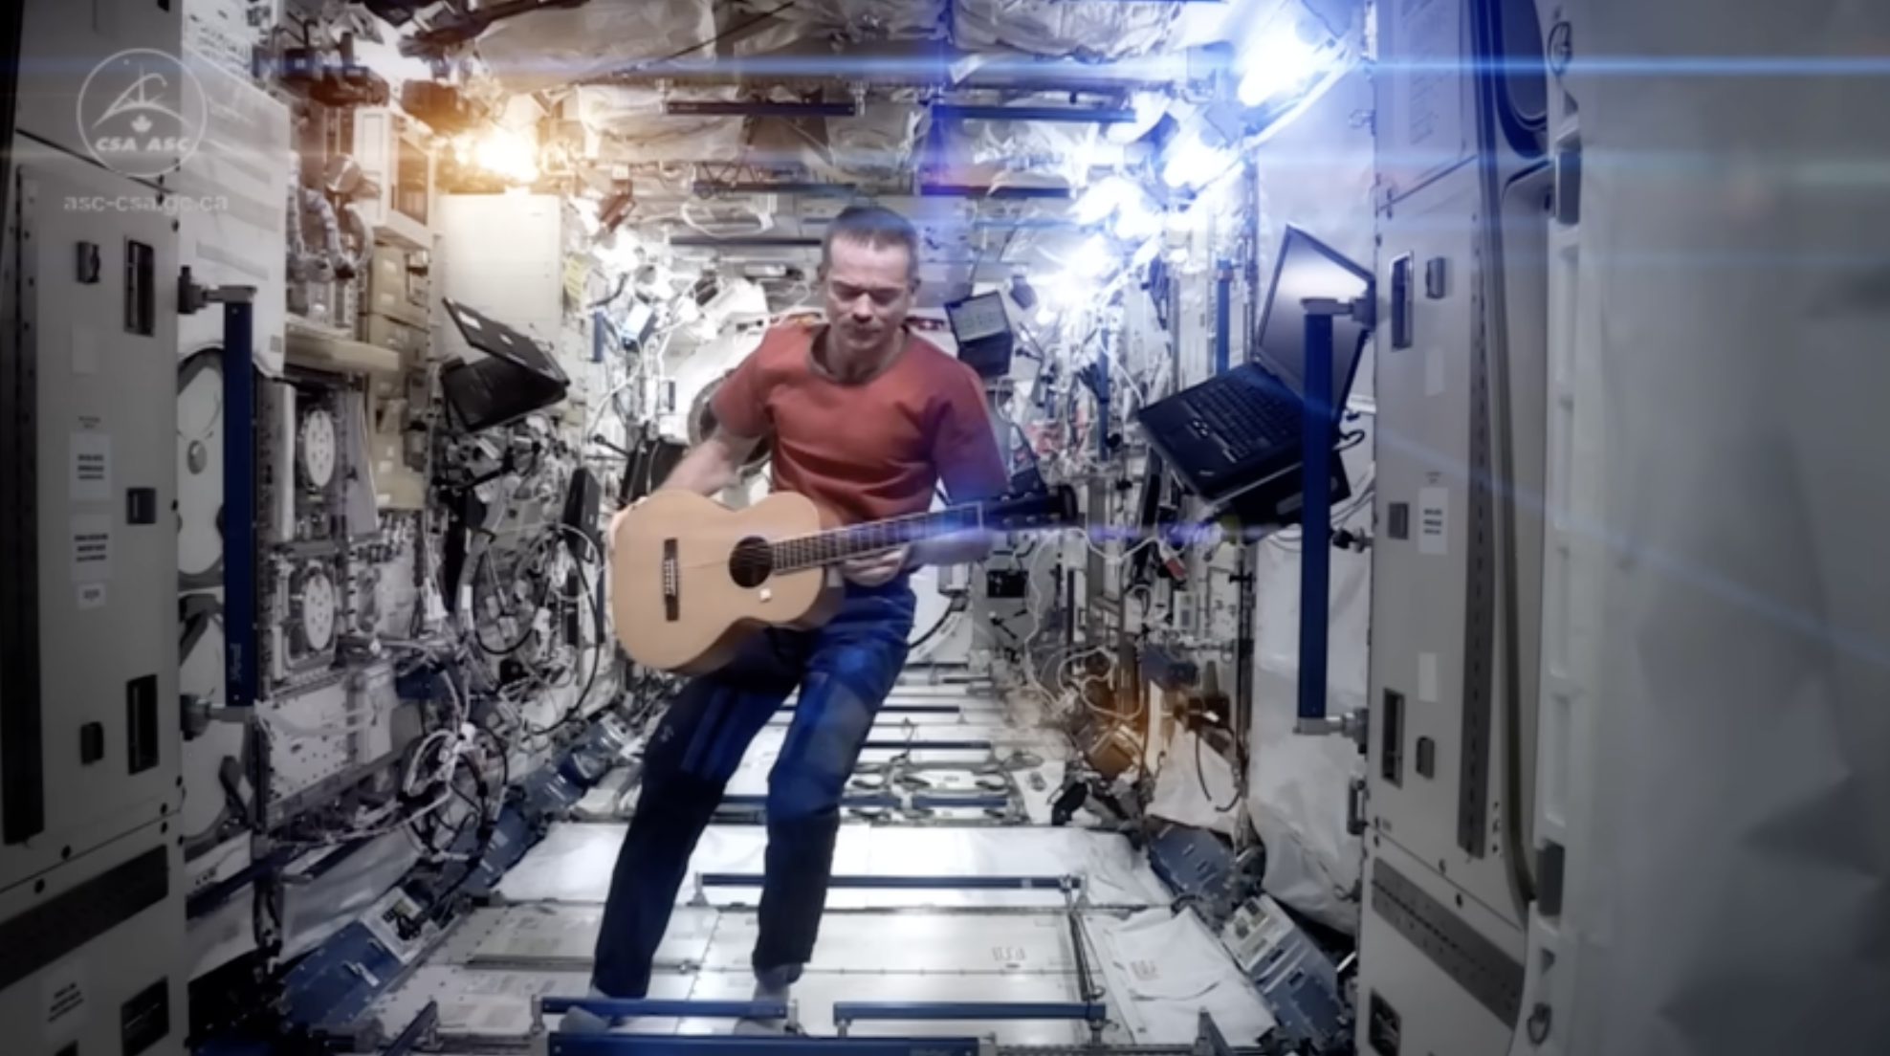
Comfort in the Small Things
Space Oddity by David Bowie, recorded in space
Gained thousands of followers on social media
Recorded a whole album
Bowie described it as, “the most poignant rendition of the song he had ever heard”
Notes:
Yet despite the pressure and the isolation, Hadfield found a way of coping with what he faced. He found comfort in small things. Some of those small things became big things that went viral. When his son persuaded him to record a version of David Bowie’s ‘Space Oddity’ from space, everything changed. Hadfield’s social media accounts gained thousands of followers and the song hit the news channels. Bowie himself called Hadfield’s version ‘the most poignant rendition of the song he had ever heard’. Hadfield ended up recording a whole album up in space called ‘Space Sessions: Songs from a Tin Can’. 11 original tracks, written and recorded all whilst he was commander of the International Space Station in 2013 with a guitar he had taken onboard.
The YouTube Clip is here: https://www.youtube.com/watch?v=KaOC9danxNo (Please be aware there may be adverts that may not be appropriate so please check ahead of time!)

Slide 8
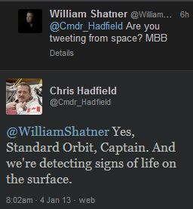
Fun and Games in Space
The actor who played Captain Kirk tweeted.
The tweets went viral.
Star Trek fans and stars of the show joined in.
They even played Scrabble up there!
The tiles had Velcro on so they didn’t cause problems!
Brought joy to those in space.
Notes:
Hadfield also had fun on social media. In January 2013, William Shatner, known for playing Captain Kirk in Star Trek, had an exchange with Hadfield asking him if he was tweeting from space. Hadfield replied to Shatner with, “Standard Orbit Captain, and we’re detecting signs of life on the surface”. Many of the Star Trek cast joined in with the tweets and fans of the show were delighted and amused.
As a lifelong Scrabble player, Hadfield also took that with him into space. The letter tiles had Velcro attached so that they could stay stuck to the roof of the station. Occasionally, when one fell out, they would have to wait for it to turn up in the air filter! A single game may last months but the familiar activity and reminder of a life on Earth, made all the difference.
In his life in space, it was reminders of Earth, music, laughter, connection and games that brought Hadfield both perspective and comfort.

Slide 9
What can we learn about life on Earth from life in space?

Slide 10
1) Look for signs of home
What is ‘home’?
It can be a physical place.
It can be people.
It can be somewhere where you feel like you are you.
It can be where you feel safe.
It can be a memory that you can recall to help comfort you.
Notes:
Look for signs of home. In the first few days of orbit, most astronauts scan the Earth for reminders of home. The Russians look for their great lakes. The Americans look for their mountain ranges. Chris Hadfield looked for Plank Road, a 19th century thoroughfare running through Southern Ontario in Canada. It had been there 150 years and was visible from space and was where he lived. Being able to say ‘that’s where I’m from’ was a comfort to him. He said that once you focus on ‘home’ you then start to see the whole world’. We can do that too. When it all feels too much and we are looking at the whole world, perhaps we need to just focus on one thing. Anything that helps us ground ourselves to be able to say, ‘that is where I am from’. Whether that is a physical place or a remembered experience or a set of values we hold dear, all of them can help us feel more grounded.

Slide 11
2) Find the small things that bring joy
What are the things that make you smile?
Being with your friends
Watching a film or a series
Playing games
Hot chocolate with marshmallows and cream
Being out in the sun
Sledging in the snow
Notes:
Find the small things that bring joy. For Hadfield, it was a Scrabble board with some Velcro attached so he could play a game, it was a guitar to play music and equipment to write and record songs. For the bland space food, he took pepper suspended in olive oil so that it didn’t fly up, scatter and make everyone sneeze. For us it will be different, but it doesn’t have to be big. It might be a moment of quiet, meeting your friends, playing a game, having a hot chocolate when it’s cold outside, watching a TV series which distracts us. When we are under pressure, everything can sometimes feel big and uncontrollable, so find the small things that make you feel good and do those.

Slide 12
3) Re-set your perspective
"Every single thing that you learn really just gives you more comfort. It's something I counsel kids all the time: if someone is willing to teach you something for free, take them up on it. Do it. Every single time. All it does is make you more likely to be able to succeed. And it's kind of a nice way to go through life”.
Chris Hadfield
Notes:
Re-set your perspective. Whatever it is you are facing, ‘This too shall pass’. There will be a time in the future when we can look at our current circumstances and say ‘I navigated that’ or ‘I managed to live there’. Hadfield did the same, he made space an extension of Earth. The night before an interview with a journalist about his time at the Space Station, he took the journalist for a stroll. He stopped, looked up to the sky and pointed at the tiniest flicker of light as the International Space Station was only just visible. “I used to live there” he said to the journalist.
Perhaps the biggest comfort of all was his ability to learn. When interviewed, Hadfield said, "Every single thing that you learn really just gives you more comfort. It's something I counsel kids all the time: if someone is willing to teach you something for free, take them up on it. Do it. Every single time. All it does is make you more likely to be able to succeed. And it's kind of a nice way to go through life”.

Slide 13
4) Sweat the small stuff
“An astronaut who doesn’t sweat the small stuff is a dead astronaut.”
Small things matter:
The small things that bring joy or comfort
Getting your bag packed the night before
Going to bed at a decent time!
Doing things that make you laugh
Taking care of the presentation of your work!
Notes:
What did Hadfield believe was one of the secrets to his success? Sweat the small stuff. Perhaps his most quoted saying is, “An astronaut who doesn’t sweat the small stuff is a dead astronaut.” The small stuff mattered for him, and it matters to us too.

