Slide 1
Notes to staff
Speed Dating
This is designed for assembly or tutor time.
You can listen to the Pearl episode anywhere you get your podcasts to get the full story.
You can also download the transcript for your own preparation.
The assembly has been edited to fit more with students and be relevant to them.
There are notes at the bottom of each slide for reference.
We would love to hear how it has gone, email admin@pixl.org.uk

Slide 2
Speed Dating

Slide 3
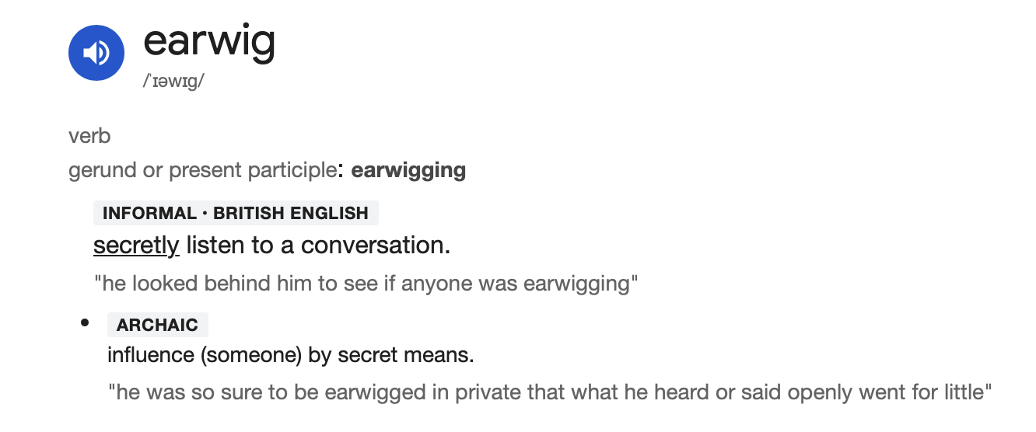
People Watching/Listening
Notes:
Have you ever been to a restaurant and found yourself distracted by the conversation of others around you? Or intrigued by the dynamic you can see playing out? Whether you can see people getting on famously or the total opposite, it can be fascinating to watch if you are interested in people and dynamics. Even if you don’t do this in real life, much of our time is spent watching communication between people play out on our TVs or cinema screens. There is something fascinating to us about how humans interact with each other. In the UK, we even have a slang term for this which is ‘to earwig’. Apparently, in the past, people thought that an earwig would crawl into your ear.
One of the most interesting interactions to watch from afar is speed dating. It’s unlikely you will have ever been able to be a fly on the wall at such an event, so let me explain some more about what the research has found!

Slide 4

Speed Dating
How did it all begin?
1998
Rabbi Yaacov Deyo
LA, in the USA
12 dates, hopping from one chat to the next
Responses on a spreadsheet
Notes:
In 1998, Rabbi Yaacov Deyo invited a group of friends over to his house in LA to come up with ideas as to how to best serve his community of single people. Being based in LA, the group of friends came from all sorts of backgrounds, some from the entertainment industry, including one who produced game shows. That evening they identified one of the community challenges was singles meeting other singles in a deliberate way and with maximum time efficiency. So, that night, the group designed a fast-paced game in which the participants would gather together, hop from conversation to conversation and have 12 dates in one evening. They would use an Excel spreadsheet to keep track of the activity and collect responses on feedback cards to see if there were matches. Although this wasn’t a totally new concept, the popular custom of ‘New Year’s Calling’ in the 1800s didn’t make it into modern times… but was perhaps a pre-cursor to Deyo’s new version.

Slide 5
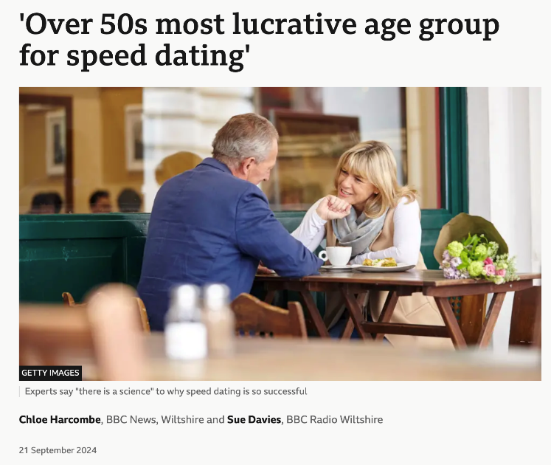
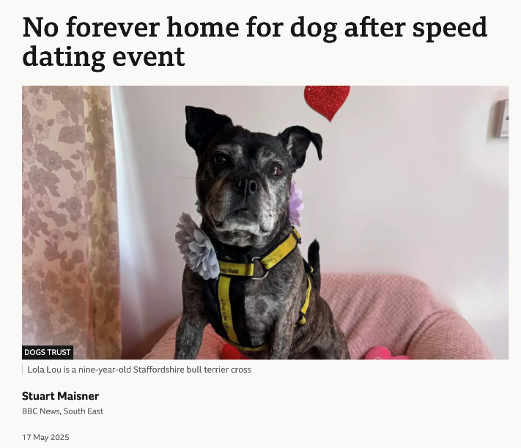
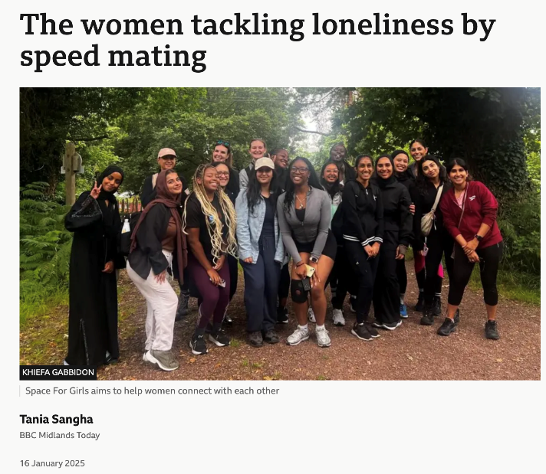
It went viral – still is!
Notes:
Soon, the speed dating idea grew to new levels of popularity and had gone viral, being imitated around the country and then the world. However, not all of the imitations had the same ethos that the original concept had had. Deyo started to feel a little uncomfortable by the new iterations. By 1999, a TV programme had been commissioned where each person talked to each other like they were trying to sell themselves in an auction. It may have been compelling viewing, but it wasn’t creating meaningful connection which had been the original intention.
Whether it is running speed dating events to find a friend, a romantic partner or a pet, the speed dating idea took off.
Deyo and his friends had trademarked SpeedDating and had started the patenting process but, as the recent TV shows had illustrated, they had lost control of the idea. So, unusually, they decided to give the concept away and allow anyone who wanted to use it to do so in the hope that it would create relationships of connection and longevity. An act of generosity they hoped would create good for many.
The rest, of course, is history. Since those early days of 1998, the world has exploded with variations of speed dating: whether in new dating apps, or TV shows like Love Island that borrows some of the speed-dating methodology. But, interestingly, since 2024, surveys have shown that there appears to be a return to Deyo’s traditional speed dating format from 1998.

Slide 6
Why is it so popular?
Real conversation
Rejects highly curated images
Can be more present in the moment
Back and forth conversation
Face-to-face, real-time chats
Beyond only appearance
Notes:
A new generation of adults are reportedly fed up of dating apps, with romance feeling like another chore to be managed. They reject highly curated and inauthentic images and content which means you don’t really know if what you see can be believed. They say they want real connection instead of that being replaced with monotonous swiping. According to a Guardian article in 2024 investigating the rise of speed dating in Australia, bookings for these events have soared in the last two years. Despite all the technology at their fingertips, perhaps people have reached a point where they are ready for honest, real-time, face-to-face conversations.
Perhaps this is a new generation, engaging with an old concept to achieve the same thing – meaningful, authentic connection that goes beyond only appearance.

Slide 7
How can we talk to each other better?
Notes:
Speed dating is not just a fun, novelty concept; research studies time and time again are showing the positive impact the format can have. But why? What is it that works? What are the ingredients of connection and how can that help us in our day-to-day lives and leadership? Although the research is coming from speed dating, we can apply it to conversations more widely.

Slide 8
1) Words really do matter
Humans really like:
A sense of connection when we are speaking
Being appreciated and hearing appreciated language
When sympathy is expressed, e.g. ‘that must be tough’
When people show us their listening (but be careful about interrupting!)
Notes:
1) Words really do matter. An analysis of nearly 1000 dates found that how the words are delivered, when and for how long makes a difference to how people feel towards each other… and, whether there was a sense of connection or not. When the feedback from dates was analysed, researchers discovered that participants felt a connection when there was appreciative language like ‘good for you’ or ‘that’s awesome’. They also liked it when sympathy was expressed, for example, ‘that must be tough on you’. Women specifically commented on clicking with their partners when they interrupted them, although crucially, this was not an interruption to redirect or steal the conversation but to show understanding by finishing, or adding to, a sentence.

Slide 9
2) 4 minutes is enough
Meaningful connections can be established in 4 minutes
Speed is not a barrier.
We make sophisticated judgements on ‘thin slices’ of information.
If we agree we are both feeling awkward, connection grows!
Notes:
2) Four minutes is enough to establish a meaningful connection. It turns out that speed is not a barrier. Studies from Stanford found that one 4-minute date was enough to form a connection that goes beyond looks and motivation. Studies have also found that we can make ‘remarkably sophisticated social judgements based on ‘thin slices’ of behaviour lasting 5 minutes or less’. Even when the conversation is awkward, connection happens when we agree it is awkward; it turns out that 4 minutes is enough to share some vulnerability too.

Slide 10
3) Planning talk helps!
There are some things that really do help:
Plan a topic of conversation ahead of time – even just for 30 seconds.
Think of some questions to ask – it helps us relax and be present.
When we plan, we say less ‘ummms’ and ‘urrrs’ and feel more confident.
Notes:
3) Planning talk makes all the difference. Of course, two people can amble through a 4-minute conversation but research shows that it is far more beneficial, effective and less stressful if we plan a topic we might talk about. Our stress is also reduced if we plan some questions we could ask. Far from being manufactured, it helps us relax and be present as we ‘cognitively offload’. Studies have shown that telling participants to think ahead about possible topics, even for just 30 seconds, increased the fluidity of their conversations … especially at that awkward transition point in conversation. Data showed when they did this, they used less ‘ummms and urrs’, took shorter pauses and privately they felt less anxious and more confident.
In turn, if you’re less anxious and more confident, it is likely you come across better to the person you are talking to! Win win! It’s the same with questions; always have a few good ones up your sleeve like, ‘what can we celebrate about you?’ or ‘what have you been excited about recently?’. Questions like this unlock content and create connection.

Slide 11
So now what?
Notes:
Clearly, not all of us will be engaging in speed dating in the coming weeks or months but we will all be engaging in conversations that might even go more smoothly if we pay attention to the lessons from it. Here are some questions to reflect on to make sure your conversations are full of connection and make you feel more comfortable, whether that is in school or at home!

Slide 12

Be a fly on the wall of your own conversations
Notes:
Be a fly on the wall and watch back in on a conversation you have had today. What kind of interruptions were present? Were they interruptions to take back the focus of the conversation, talk over someone or to change the direction of it? Or was it to add to what had been said, finish a sentence or give affirmations which build connection? One helps, one hinders. What have you done? And what have you had done to you?

Slide 13
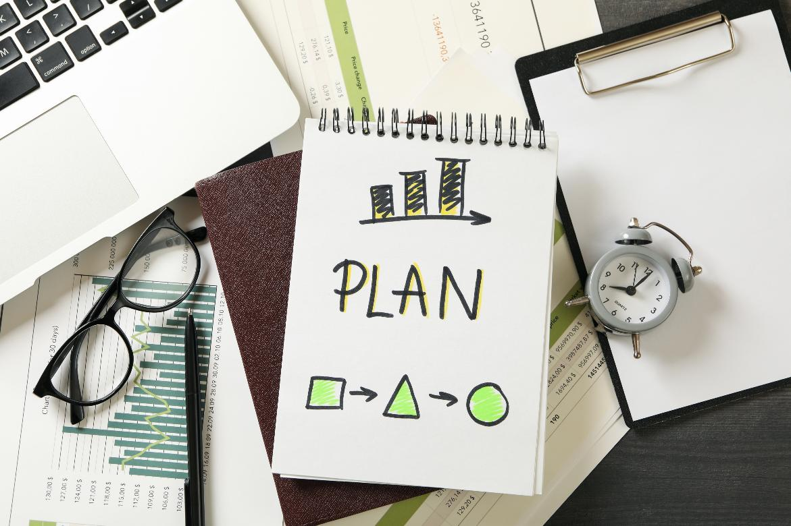
Pre-plan topics to talk about
Notes:
What topics or approaches could you pre-plan so you are able to be as natural and comfortable as possible and reduce cognitive overload in the moment? We all have a lot of 4-minute conversations, and we know you can achieve a lot in 4 minutes if the conversation is a good one. Think of colleagues in the corridor, students in a school, parents at a gate or on the phone, or any strangers or stakeholders that you work with. How could you plan?

Slide 14
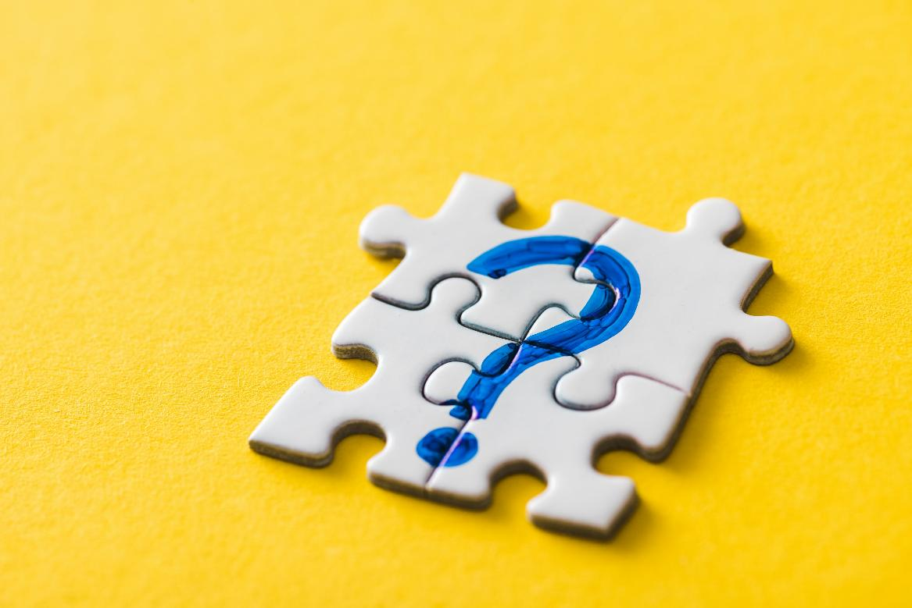
Plan questions to ask.
Notes:
Why not plan some questions? We know from the research that good questions unlock different levels of connection in a conversation and help you move up and down the conversation elevator. Questions also help you get out of the usual ‘weather’ or ‘how’s your journey’ small talk that many people find awkward. And the good news – research shows that people really do love being asked lots of questions!

Slide 15
Talking builds connection.
Connection helps us feel we belong.

