Slide 1
Notes to staff
Unintended Opportunities
This is designed for assembly or tutor time.
You can listen to the Pearl episode anywhere you get your podcasts to get the full story.
You can also download the transcript for your own preparation.
The assembly has been edited to fit more with students and be relevant to them.
There are notes at the bottom of each slide for reference.
We would love to hear how it has gone, email admin@pixl.org.uk

Slide 2
Charm

Slide 3
What do we mean by ‘charm’?
Started as ‘magic charm’ or ‘song’ or ‘enchantment’
Then, ‘to win over by treating pleasingly, delight’
Then, ‘a pleasing quality, irresistible power to please and attract’
Notes:
The word ‘charm’ has meant slightly different things to different people over the years. Starting out as a ‘magic charm’ or a ‘song’ or ‘enchantment’, the definition then morphed into something different. Between the 15th and the 17th century, it came to mean ‘to win over by treating pleasingly, delight’ and then ‘a pleasing quality, irresistible power to please and attract’. We even have a term for when leaders have to turn on the charm – “the charm offensive”. Charm offensives can be genuine or they can be a vehicle to manipulate.

Slide 4
But when is charm a problem?

Slide 5
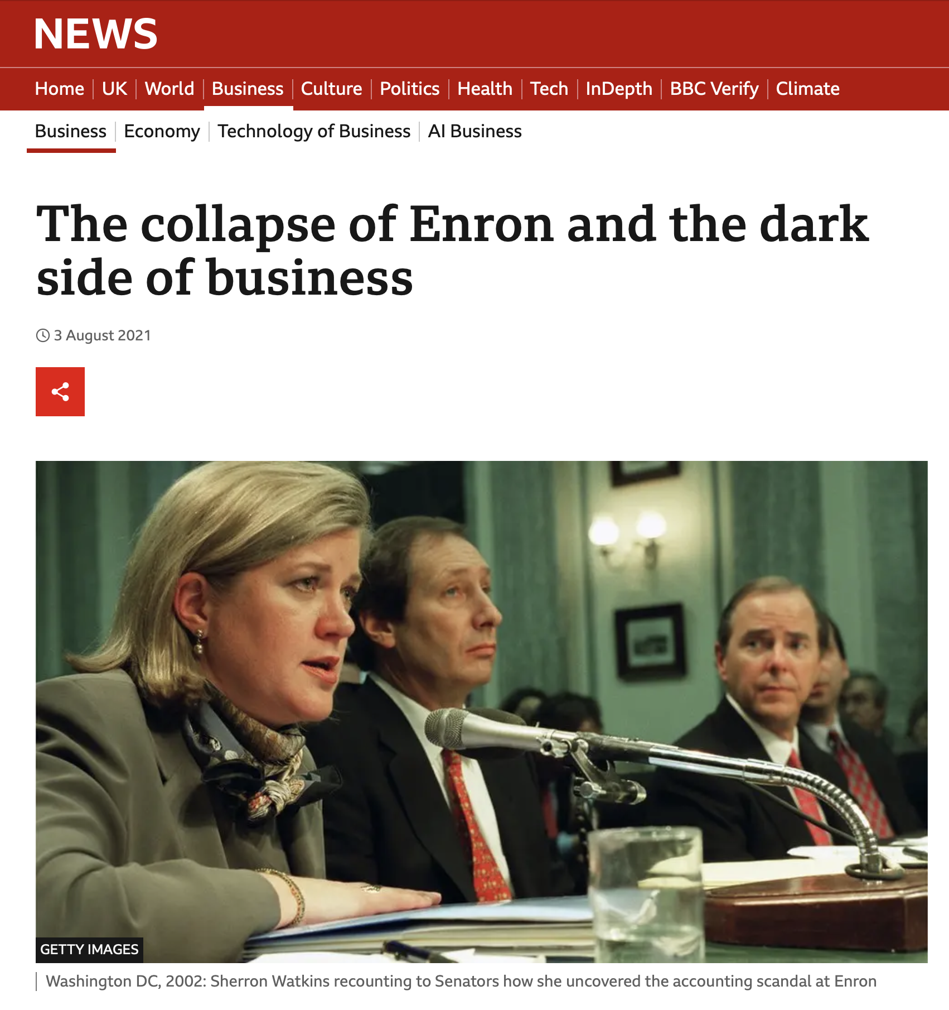
When charm causes chaos
A large energy company
Declared bankruptcy
Expanded too fast
Hidden things from investors
High-risk accounting
A big cover-up
Notes:
When charm tricks and deceives, the consequences can be huge.
In the 1990s, the ENRON Corporation was loved by Wall Street. It was one of the largest energy companies in America and was hailed for its innovative use of technology and was expanding rapidly. An example of the American Dream, soon it turned to a nightmare almost overnight. The share price tumbled and the company had to declare bankruptcy.
Many were left wondering what had happened.
When Enron was investigated, it was clear what had happened. They had crumbled under the weight of their own expansion and had hidden things from investors who had no idea what was happening. But not only that…there was clear evidence of high-risk accounting and auditing processes as well as a cover-up. Public outrage and calls for accountability followed.
The public wanted to know how these executives had got away with it, there was fraud on such a large scale involving so many people. Although complex and multi-faceted, one of the reasons given was the ‘charm’ of Enron’s top executives. They had rubbed shoulders with government, been touted for top jobs, in some cases were charismatic. The charm of some of the individuals masked some of the much deeper issues behind the smiles. The charm that CEO Ken Lay was known for may have contributed to a culture where concerns about the company’s accounting practices were overlooked.
Screenshot: https://www.bbc.co.uk/news/business-58026162

Slide 6
We can fall for charm
Can you think of any characters in films who are charming but manipulative?
Notes:
Commentators said that Lay could speak in platitudes and drew people to him. Using his charm, he eventually persuaded them to commit fraud, not for him directly but for Enron. His use of charm created a distraction and a smokescreen, behind which terrible things were happening. In his charm there was manipulation. There is a dark side to charm where it serves the charmer and not the follower, where the line is crossed into bad or unethical behaviour. At times, people can be pulled along with the tide not even realising what is happening, until they see it clearly and then do something about it, as was the case with the whistle-blowers at Enron.

Slide 7
Charm is not always a bad thing though.

Slide 8
“Charm will not feed the hungry, end wars, fight evil, yet I happen to believe that the lives of almost all of us are the better for encountering charm…It provides a form of necessary relief—relief from the doldrums and the drab everydayness of life. Charm widens the lens, heightens the colour of life, intensifies and sweetens it. We can, of course, all live without it. What a great pity, though, to do so.”
Joseph Epstein in his book Charm: The Elusive Enchantment.
Notes:
This quotation is from Joseph Epstein in his book ‘Charm: The Elusive Enchantment’.
And yet, charm is not a bad thing in and of itself. Natural charm is honest, asks for nothing in return and focuses on making people feel connected. Charm can help align people to be part of an organisation that works for the greater good, benefitting more than itself. Charm is elusive, it is something we FEEL in the presence of others. We will all know people who exude charm, who seem genuine and who make us feel great, and that can be brilliant. Charming people who seek to serve others rather than themselves are people who add, not diminish. Life would be less magical without these people in our lives.
Although the specific circumstances around the Enron crisis are unlikely to happen again, we may not have learned all the lessons yet from the crisis. Where there are unchecked magnetic personalities, charm used for underhand intentions, perverse incentives, weak oversight, a lack of ethical practices and too many people who stay silent, these things can always happen.

Slide 9
The 5 ‘Charming Techniques’ that can be used to help or harm.
Notes:
In the age where charisma and charm seems to count in the eyes of the public, it is important that we see behind the charm so that we are less able to be manipulated by it.
In her book, ‘Charm: How Magnetic Personalities Shape Global Politics’, Julia Sonnevend outlines the 5 techniques employed during the charming interaction or charm offensive. These techniques can be nothing more than a performative display OR they can be real. The job of a discerning follower is to work out which is which.

Slide 10
1) Performing Authenticity
This is when people adjust the performance to appear ‘real’ and ‘relatable’.
Key question to ask: If there were no cameras here to see this, would they still be doing it or is this a performance to manipulate our opinions?
Notes:
Performing authenticity. This is when people adjust the ‘performance’ to appear ‘real’ and ‘relatable’. This is a popular technique at election time when we see people visiting McDonalds, or saying they worked there, kissing babies, eating bacon sandwiches or nipping into Greggs. Sometimes these shows of ‘authenticity’ don’t help the person at all, often ending up as pictures in the press with unfortunate headlines. If we see these displays but do not believe them, then we label people ‘fake’. Perhaps the key thing to ask here is, ‘if there were no cameras, no press and no social media, would you still be doing these things or is this an elaborate performance for your own gain?’

Slide 11
2) Demasking
This is when we allow people to see our vulnerable selves.
Key question to ask: When people allow us to see their vulnerability, do we then mock it or do we really appreciate seeing the ‘real’ them?
For example, a celebrity without make-up or a sports player in tears?
Notes:
Demasking. This is when there is an attempt to remove the performer’s mask, displaying either vulnerability or strength. This is where the hypocrisy of humans can be seen. On one hand we say we like vulnerability, indeed demand it because it is authentic, but on the other hand, when someone displays it we sometimes don’t like it at all. Think about the headlines around a politician who is upset in a debate or the comments about the appearance of a Prime Minister who has just given birth or the scrutiny of a Royal who has been forced to announce she was ill. Demasking can also be used to show others that we are an ‘everyday normal person’. This can work well, it helps people see us as human but if too manufactured… or forced… or fake, it can backfire.

Slide 12
3) Breaking from routine
This is when people allow us to see ‘behind the scenes’ so we feel like we really know them.
Key questions to ask:
How do I know this is real and not manufactured to look real?
When has this worked and I have really loved finding out behind the scenes information?
Notes:
Breaking from Routine. People interrupt the flow of time to create minor, substitute ‘pseudo-events’. This can be an event that unites people such as a wedding or a national commemoration. It can also be a moment within a moment, for example when we get a behind the scenes look at people before the main event or capture a conversation with a member of the crowd. Often people go down rabbit holes on social media trying to find these off-script moments. It helps make people ‘real’ to us.

Slide 13
4) Re-staging or un-staging
This is when a famous person appears where there is no stage
Key questions to ask:
If this was a purely natural moment that was not staged, why are there cameras there?
Why is it important that we capture these ‘un-staged’ moments? What does it help us see?
Notes:
Restaging or un-staging. This is when leaders may appear in an unusual place which appears to have no stage. Think a presidential candidate who may serve fries in McDonalds, wear a high vis or answer questions from the roof of a building. It might be a moment when two world leaders are having a ‘casual chat’ as they walk or it might be a leader taking people behind the scenes or releasing a video of those private moments. These moments that are created but appear natural help charm shine through, for good or for ill.

Slide 14
5) Equalizing
This is when people present diverse audiences as a coherent community and bring them together in unity.
Key questions to ask:
What change is this event trying to bring about?
How do people feel at events where they are together with others who want the same thing?
Notes:
Equalizing. This is when people present diverse audiences as a coherent community and bring them together in unity. This can create a ‘them’ and ‘us’ situation in its most negative iteration OR it can be used to empower. At music concerts the kind of equalizing can be euphoric as different people, from different contexts, come together to enjoy the same artists. Equalizing can unite or it can divide depending on the intention of the person deploying the technique.

Slide 15
These techniques can be used to help or to harm.
Notes:
When it comes to ‘charm’, and people with ‘charm’, we have to apply some discernment. Charm can be a great tool in honest hands when it is about listening to and connecting with others. How can we make sure we are discerning with others and don’t fall into this charm trap ourselves?

Slide 16
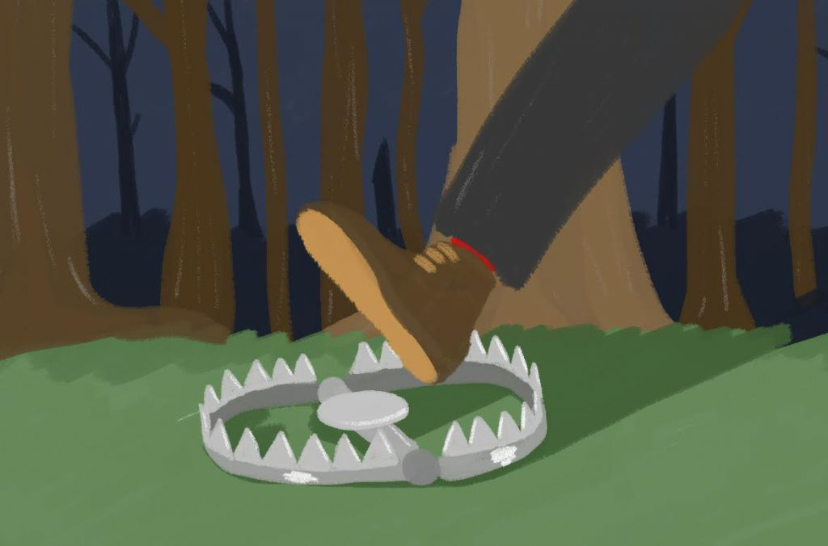
How can we avoid the ‘charm trap?
Don’t believe everything you see.
Check out that what you see is REAL.
Check that actions and words match.
Notes:
Don’t believe everything you see – pictures are often staged, we show our best selves, we take multiple takes – some of it is people trying to look better than they are and persuade you to believe it.
Check out that what you see is real. Do other people know this person? Are they really who they say they are?
Check that actions and words match. Anyone can say words, but is there evidence to prove they mean what they say?
We live in an age where fame and celebrity, stardust and charm are celebrated and prized. And there is a place for charm, life would be dull without it and connection can be formed using it. But let’s also never forget to engage our brains and our discernment so we don’t fall for appearance over reality.

Slide 17

How can we use charm for good?
Let people see the real you and connect with others.
Bring different people together for a purpose.
Be polite and friendly, people feel good when you are!
Notes:
Let people see the real you and connect with others.
Bring different people together for a purpose.
Be polite and friendly, people feel good when you are!

Slide 18
“We live in an age where fame and celebrity, stardust and charm are celebrated and prized. And there is a place for charm, life would be dull without it and connection can be formed using it. But let’s also never forget to engage our brains and our discernment so we don’t fall for appearance over reality.”
Notes:
Quote from Rachel Johnson, PiXL Pearl, Charm episode.

