Slide 1
Notes to staff
Sorry
This is designed for assembly or tutor time.
You can listen to the Pearl episode anywhere you get your podcasts to get the full story.
You can also download the transcript for your own preparation.
The assembly has been edited to fit more with students and be relevant to them.
There are notes at the bottom of each slide for reference.
We would love to hear how it has gone, email admin@pixl.org.uk.

Slide 2
Sorry

Slide 3
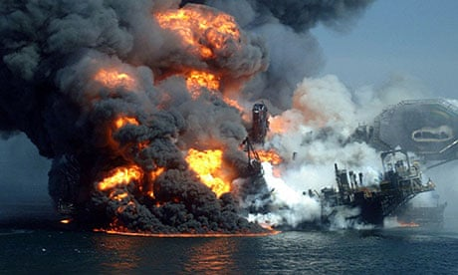
The Deepwater Horizon Oil Rig Disaster
April 20th, 2010,
Notes:
Picture credit: https://www.theguardian.com/environment/blog/2010/sep/08/bp-oil-spill-report-live
On April 20th, 2010, the largest oil spill in history occurred. The devastating spill was caused by an explosion on the Deepwater Horizon oil rig located in the Gulf of Mexico, 41 miles off the coast of Louisianna. Two days after the explosion, the oil rig sank. 11 workers were killed and 17 were injured. Terrible scenes were beamed across the world. Thousands of barrels worth of oil began to leak into the Gulf. BP estimated it to be 1000 barrels a day but the US government officials estimated it to have peaked at more than 60,000 barrels per day. There were early reports of a five-mile-long oil slick and thousands of people were sent to start the clean-up operation.
This was a disaster, plain and simple. This was BPs oil rig, their workers, their fault, so perhaps the least you could expect would be an unequivocal apology? Yet that is not what happened. Remarkably, BP’s bosses made it worse.

Slide 4
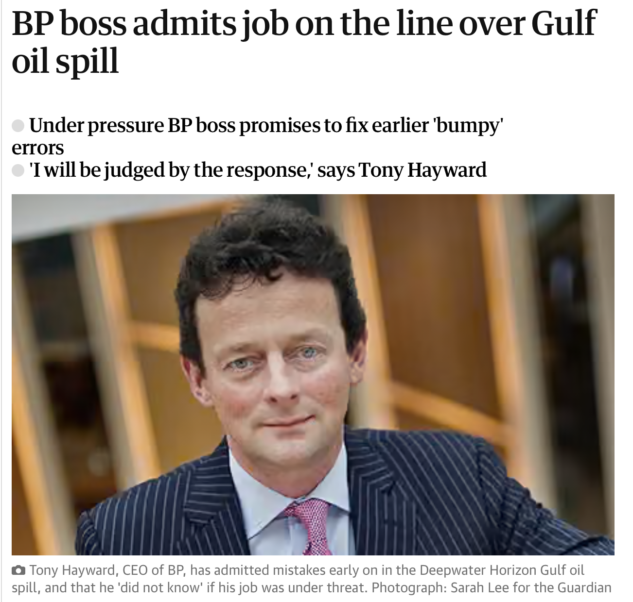
Notes:
Photo credit: https://www.theguardian.com/business/2010/may/13/bp-boss-admits-mistakes-gulf-oil-spill
BP’s CEO, Tony Hayward’s initial response admitted some responsibility but also attributed blame to other partners. This led to widespread criticism of BP’s communication strategy and Hayward was criticised for being both insensitive and insincere. It seemed that he was so keen to distance himself from blame that he and the company were willing to throw anyone else they could into the frame. They blamed a chain of other people’s failures. On the 3rd May in an interview with NBC, Hayward said:
"Well, it wasn't our accident, but we are absolutely responsible for the oil, for cleaning it up, and that's what we intend to do. The drilling rig was a Trans-ocean drilling rig. It was their rig and their equipment that failed, run by their people and their processes."
The shocked public looked on: where was the apology? The regret? The part where you take responsibility? The empathy and compassion that was required? But it soon got even worse.

Slide 5
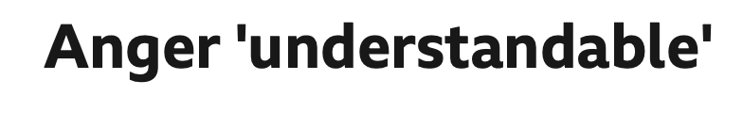
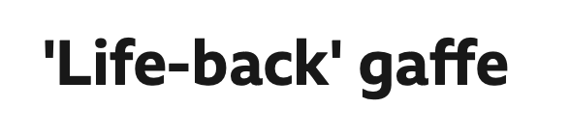
The CEO refused to apologise.
Notes:
On the 14th of May, Hayward claimed the amount of oil was ‘tiny in relation to the total water volume’. Then on the 18th of May, he said the environmental impact would be “very, very modest”. Anyone watching the TV coverage could see this was unlikely to be the case.
Perhaps the ultimate PR low point was on the 30th of May when Tony Hayward did say sorry.
"The first thing to say is i'm sorry”, he said, "We're sorry for the massive disruption it's caused their lives. There's no one who wants this over more than I do. I would like my life back."
“I would like my life back”. If ever there was a bad comment at an even more terrible moment, that was it. 11 people had lost their lives, miles of oil was pouring into the Gulf, the disruption was huge. Yet Hayward’s thoughts, after blaming others, was to then focus on himself and HIS inconvenience and HIS stress. President Obama waded in to say Mr Hayward ”won’t be working for me after any of those statements". Public figures were distancing themselves from him and public trust in the company was hugely damaged. It was a PR disaster.
Days later, a remorseful Hayward gave another statement, apologising for this ‘thoughtless comments’ and telling people that his first priority would be doing all they could to restore the lives of the people of the Gulf region and their families. He said he wanted “to restore their lives, not mine."
Hayward left BP in 2010 just after the oil disaster. There was too much damage; reputationally and environmentally. Faith and trust had been lost. Staying there to clear up the mess he had made worse, became untenable.

Slide 6
Why is ‘sorry’ so hard to say?
Notes:
Hearing that story you may be thinking why was it so hard just to say ‘sorry’? And yet we find this time and time again. Even when ‘sorry’ is the only word to say, it is the last one some want to utter. And yet perhaps it is not as simple as saying ‘sorry’, people need more than that for it to be a meaningful apology.

Slide 7
The 6 Ingredients of an Apology
1. Expression of regret
2. Explanation of what went wrong
3. Acknowledgment of responsibility
4. Declaration of repentance
5. Offer of repair
6. Request for forgiveness
Roy Lewicki
Notes:
According to Roy Lewicki, lead author of the study on apologies at Fisher College of Business, there are 6 components to an apology if you want it to be really effective. But if circumstances mean that’s a challenge, then there are 2 that definitely cannot be missed if you want to have a chance of your apology being accepted. The researchers tested how 755 people reacted to apologies containing anywhere between one and six of the following elements:
1. Expression of regret
2. Explanation of what went wrong
3. Acknowledgment of responsibility
4. Declaration of repentance
5. Offer of repair
6. Request for forgiveness

Slide 8
The most important elements?
Acknowledgment of responsibility
Offer of repair
Notes:
Although all are important, not all are equal. The research showed that the most important component is acknowledging responsibility. That was the key ingredient missing in the BP oil disaster. The second most important element was an offer of repair. People want to know that not only do you take responsibility but you are prepared to do something to fix what has gone wrong. People want action, not just empty words.
After these crucial 2 elements, the next 3 were all tied in terms of effectiveness: expression of regret, explanation of what went wrong and declaration of repentance. The least effective element is a request for forgiveness. If you have to leave that out, apparently you can and still have an effective apology.

Slide 9
How can we show we are sorry?
Try some of these things:
Mean ‘sorry’ when you say it.
Be specific about what you are sorry for.
Try and make things right again.
Recognise the emotions of the other person.
Notes:
And it isn’t just the words that matter or the components of an apology, you have to actually mean what you’re saying. The emotion and voice inflection of a spoken apology really is powerful. Eye contact, appropriate expression of sincerity and actually meaning it and looking like you do, is clearly crucial.
Apologies that focus on YOU and how you feel or why you did it won’t cut it if you are apologising to someone else. “I’m sorry but” is not an apology. To apologise, and mean it, we have to see that what we have said, or done, has hurt or upset someone. We have to acknowledge that and our part in it. It takes humility. It takes courage. It takes parking the ego and the pride and connecting to someone we have wronged.
Perhaps that is why ‘sorry seems to be the hardest word,’ because it is so much more than a word.

Slide 10
We should avoid…

Slide 11
“Sorry but…”
We should avoid this phrase because:
It is not saying sorry at all.
What follows the ‘but’ is usually an accusation.
It usually starts another argument.
It usually means you are not accepting responsibility.

Slide 12
Have a think!
What is the hardest thing for you about saying ‘sorry’?
What stops you apologizing when you know you need to?
If people said ‘sorry’ and meant it, how would things feel different?

