Slide 1
Notes to staff
Lincoln’s Beard
This is designed for assembly or tutor time.
You can listen to the Pearl episode anywhere you get your podcasts to get the full story: https://www.pixl.org.uk/podcasts
The assembly has been edited to fit more with students and relevant to them.
There are notes at the bottom of each slide for reference.
There is a part 2 of this story coming soon!
We would love to hear how it has gone, email admin@pixl.org.uk

Slide 2
Lincoln’s Beard

Slide 3
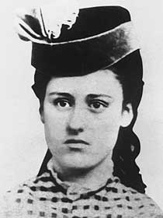
You won’t have heard of this lady.
This is Grace Bedell
Notes:
You won’t have heard of this lady. This is Grace Bedell. When Grace was 11, she did something that changed her life and the lives of others.

Slide 4
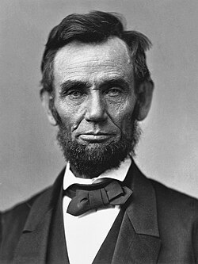
You will have probably heard of this man.
This is President Abraham Lincoln.
How are these two people connected?
Notes:
You may have heard of this man. This is Abraham Lincoln who was the President of the United States of America. These two people, Grace Bedell and Abraham Lincoln, are connected. But how?

Slide 5
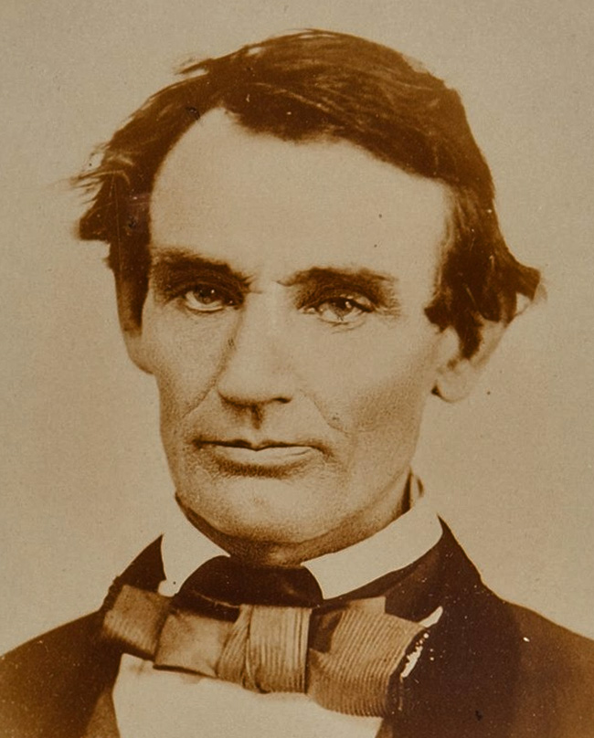
Before Lincoln was elected President, he looked like this.
Notes:
In October 1860, a few weeks before he was elected as the President of the United States of America, Abraham Lincoln received a letter from an 11-year-old girl from New York called Grace Bedell. Receiving letters was not unusual for a President Elect of course, but this one stood out. In this letter, Grace Bedell had some bold comments, not on his politics, but on his physical appearance having seen a picture of him from August that year.

Slide 6
A letter… and a change
Dear Sir,
My father has just come from the fair and brought home your picture and Mr. Hamlin's. I am a little girl, only 11 years old, but I want you to be President of the United States very much so I hope you won’t think me very bold to write to such a great man as you are.
I have got four brothers and part of them will vote for you any way and if you let your whiskers grow I will try and get the rest of them to vote for you, you would look a great deal better, for your face is so thin. All the ladies like whiskers and they would tease their husbands to vote for you and then you would be President. My father is going to vote for you, and if I was a man, I would vote for you too but I will try to get everyone to vote for you that I can.
I must not write any more, answer this letter right off.
Goodbye!
Grace Bedell
Notes:
Perhaps the tone or the content or the suggestions in this letter is a surprise, but what is perhaps even more surprising, is what happened next.

Slide 7
An unexpected reply…
Lincoln replied quickly. He thanked Grace for her letter and then said:
…as for the whiskers, having never worn any, do you not think people would call it a silly affectation if I were to begin it now?
Your very sincere well-wisher,
Abraham Lincoln.
Notes:
Lincoln replied quickly. He thanked Grace for her letter and then said, ‘as for the whiskers, having never worn any, do you not think people would call it a silly affectation if I were to begin it now?
Your very sincere well-wisher,
Abraham Lincoln.
This seems a small matter to be occupying the time and energy of the President Elect, but Lincoln perhaps had reason to ask the question. Up until that moment, no President had worn a full beard, and only one had had some facial hair… so this would be breaking from tradition.

Slide 8
The letter made a difference!
What happened next?
Lincoln grew a beard just like Grace had said he should.
He was the first President to have a full beard, breaking tradition.
The image of him with a beard became the iconic picture of his Presidency.
He met Grace at a rally that was being held when he was elected President.
Notes:
Shortly after this exchange, Lincoln grew a beard. The photograph taken on the 12th August 1860 was his last beardless photograph. On the 25th November, one month after Grace’s letter, a new photograph was released of Lincoln wearing a partial beard. By February 9th 1861, he was photographed with a full one which became the iconic image of his time as President.

Slide 9
'Gracie,' he said, 'look at my whiskers. I have been growing them for you.'
Notes:
On the way to his inauguration by train, Lincoln stopped off at a village to meet the crowds of supporters. Whilst there, he recounted the story of Grace’s letter and his new beard and said that if this young lady was at the gathering, he would be delighted to see her. On his words, there was a commotion amongst the people as an old man struggled through the crowd holding the hand of his 12-year-old daughter. The old man introduced his daughter, Grace Bedell, to President Lincoln and the pair chatted for several minutes. The content of that conversation was recalled years later by Grace who said:
"He climbed down and sat down with me on the edge of the station platform.
'Gracie,' he said, 'look at my whiskers. I have been growing them for you.' Then he kissed me. I never saw him again."
Lincoln was the first bearded President of the United States. All inspired by an 11-year-old girl.
This story became popular following Lincoln’s assassination after his first term as President. A statue depicting the meeting of Grace and Abraham Lincoln was erected in the village where it happened. TV dramas and books were created on the back of this story in 1972, 1996 and in 2010 to mark the 150th anniversary of the events surrounding the letter.
For all the things that Lincoln could have been remembered for, why is this story one of the ones that endures?

Slide 10
Why did Lincoln grow a beard?!
1) Perhaps he had already been thinking about it, but Grace’s letter helped push him to make a decision.
Sometimes we just need some encouragement to be brave.
He was the first President to do this, so it felt a bigger move!
Sometimes we think what we do or say doesn’t matter, but it does!
Notes:
This exchange of letters shows us that we can make an impact, even if we are 11 and even to someone who is powerful. We can also encourage others and they might feel braver to take action.

Slide 11
How can we help others be braver?
This week…
Who can you encourage?
Who can you influence?
Where can you use your voice to suggest something that needs to change?
Notes:
When we may often feel like our lone voice changes nothing or that people in positions of power don’t listen, we are reminded that sometimes it is the smallest acts of speaking out that influence a change. Grace saw the impact of her letter in a way that we may never see for ours, but that doesn’t mean change isn’t happening. We don’t know if Lincoln had been thinking about a beard for a while and Grace’s letter was the nudge, or whether he was going to do it anyway and the timing of the beard after the letter was a coincidence. Or perhaps he read the letter and made the change. We can never know the true impact or consequences of our words, but this story is a reminder that our words CAN, and DO, have an impact.

Slide 12
Why did Lincoln grow a beard?!
2) It was an outside sign of an inward change.
When you go to a new school you have a new uniform.
You might get a new planner when you start the new year.
If you want to change your identity, sometimes you might change what you wear.
Some people change names, or hair colour or style as a ‘fresh start’.
Lincoln grew a beard at the start of being the President.
Notes:
As he was elected President, Lincoln’s appearance changed. It was an outside manifestation of an inward change. As he was about to assume the Presidency and become a national leader, he felt that a change was needed. It became a moment where he, and we, could see that there was a new phase about to start. Most human beings like, and need, moments like this; whether it is buying a new outfit for an interview, changing your hairstyle or look, a new pencil case to start school, a diary at the start of the new year or a change of name, all of it symbolises something has changed.

Slide 13
How can we make an outside change to show the inside change this week?
This week…
If you are going to be an organised person, how will your school bag change?
If you want to be someone who tries your best, what will your handwriting look like?
If you want to be someone who is proud of themselves, what will your uniform look like?
SHOW DON’T TELL
Notes:
If an outside change can be symbolic of an inside change then let’s think about what might happen with you this week.
Sometimes we can SHOW people that there has been an inward change, without having to tell them. If you start wearing your uniform properly, I will see that you are respecting yourself and your teachers. If you want to be organised then without telling me that, I can see it when I look in your pencil case or your bag. SHOW the change. You can also tell us too so we can celebrate you and encourage you too.

Slide 14
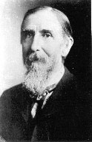
Not everyone was happy about the beard!
This man’s life and career was nearly ruined by Lincoln’s decision to grow a beard.
Notes:
Abraham Lincoln’s beard became iconic, as did the story of him and Grace. But not everyone was pleased. One person’s livelihood was ruined thanks to that beard. You will hear an extraordinary twist in the story next time we meet!
One man’s life and career was nearly ruined by Lincoln’s beard. Find out more next time I see you…
(Listen to Episode 2 of the Pearls for the next instalment.)

